Slide 1

Streamlining Emergency Care Processes at Northeastern’s UHCS: A Lean Implementation Strategy
Submitted by
Mufaddal Husain
Aditya Kaspate
Deveeka Ravi Meshram
Jainil Jain
IE 5617 Graduate Project

Slide 2
Lean approach
Problem Statement:
Northeastern University's UHCS faces issues with long wait times and inefficient urgent care prioritization. This project will introduce visual management tools to streamline patient flow, reduce waits, and improve service quality, enhancing both patient satisfaction and healthcare delivery efficiency.
1. Value Stream Mapping (VSM):
We will use VSM for identifying inefficiencies and enhancing treatment flow through elimination of redundancies.
2. Standard Work:
We've established standardized protocols to ensure consistent, efficient patient assessment and care.
3. Kanban Systems:
We will apply Kanban for visual patient flow management, prioritizing urgent care and optimizing resource allocation to reduce wait times.
4. Continuous Improvement (Kaizen):
To promote a culture of ongoing improvement through staff and patient feedback, leading to iterative enhancements in service efficiency.
IE 5617 Graduate Project
Slide 1
Notes:
2

Slide 3
Motivation & References
The motivation behind choosing this lean implementation idea came from our commitment to addressing the issues faced by Northeastern University students at the UHCS. We experienced Long wait times and inefficient urgent care prioritization. Hence, by leveraging tools like Value Stream Mapping, Standard Work, Kanban Systems, and kaizen for continuous improvement, we aim to systematically identify and eliminate inefficiencies and optimize resource allocation. Our goal is to enhance both patient experience and operational efficiency, ultimately ensuring that UHCS can better fulfill its mission of providing high-quality healthcare services to the university community.
Rother, M., & Shook, J. (1999). Learning to see: Value stream mapping to add value and eliminate muda. Cambridge, MA: Lean Enterprise Institute.
https://www.virginiamasoninstitute.org/what-is-lean-health-care/
https://postgraduateeducation.hms.harvard.edu/trends-medicine/importance-adopting-lean-mindset-culture-health-care-organizations
IE 5617 Graduate Project
Slide 1
Notes:
2

Slide 4
Northeastern’s UHCS
Current Emergency Care Flow
Self Check-In
Wait for inital screeing
In-person Evaluation
Diagnostic Tests
Treatment
Referral to Specialist
Monitoring and Follow-up
Treatment Plan
IE 5617 Graduate Project
Slide 2

Slide 5
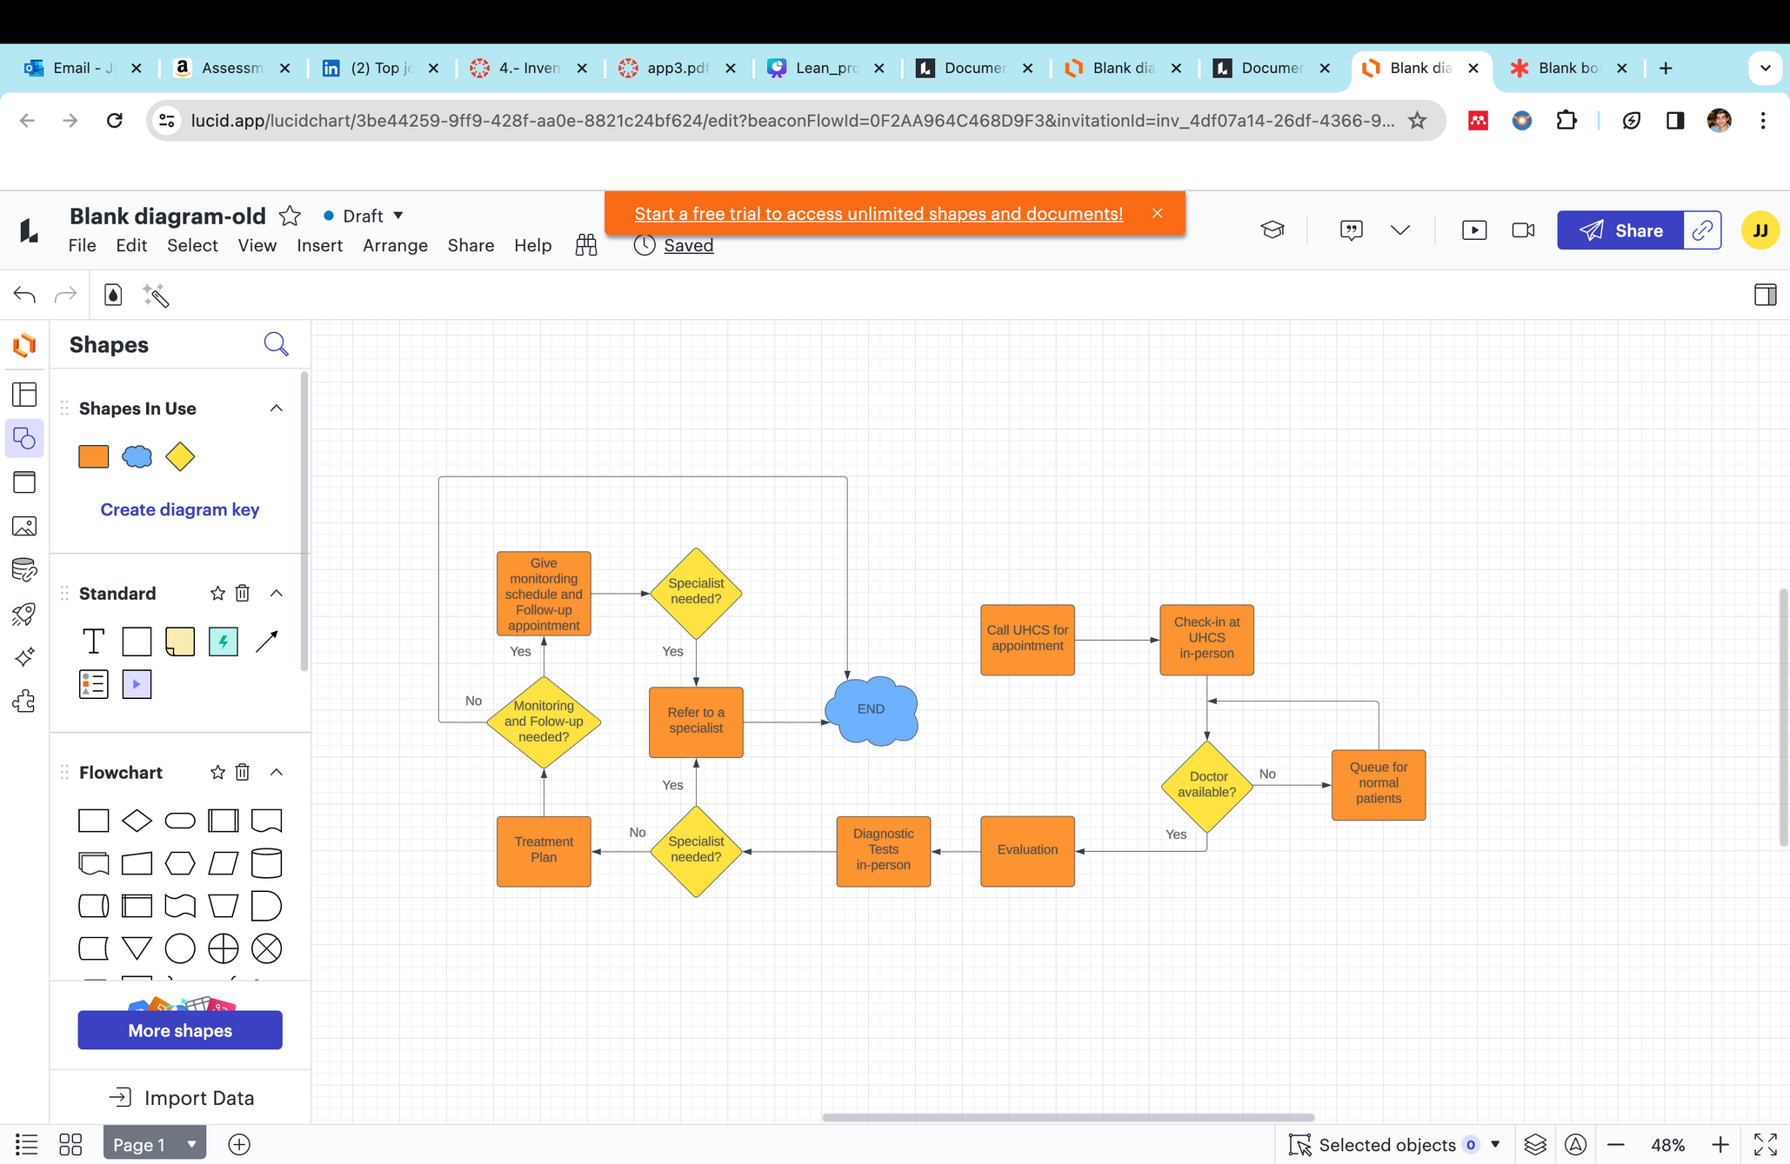
Value Stream Mapping Current Flow
1 Min
2 Min
5 Min
5 Min
(10-15 min)
5 Min
20 Min
7.5 Min
(1-10 min)
(10-15 min)
(15-20 min)
(5-15 min)
Total Cycle Time- 55.5 minutes
IE 5617 Graduate Project
Slide 7

Slide 6
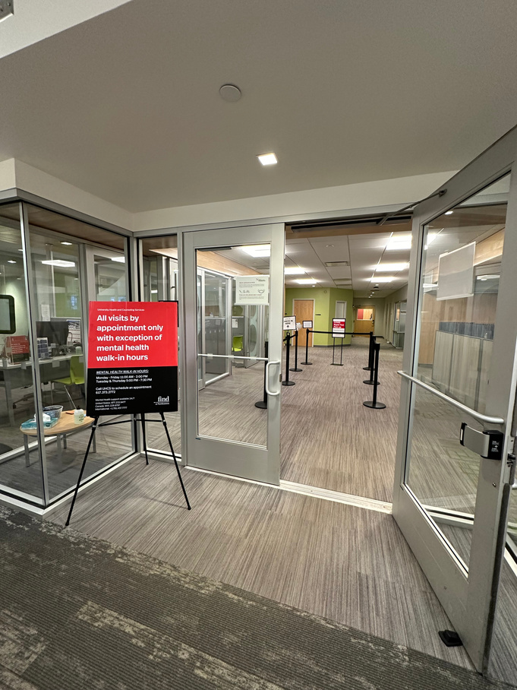
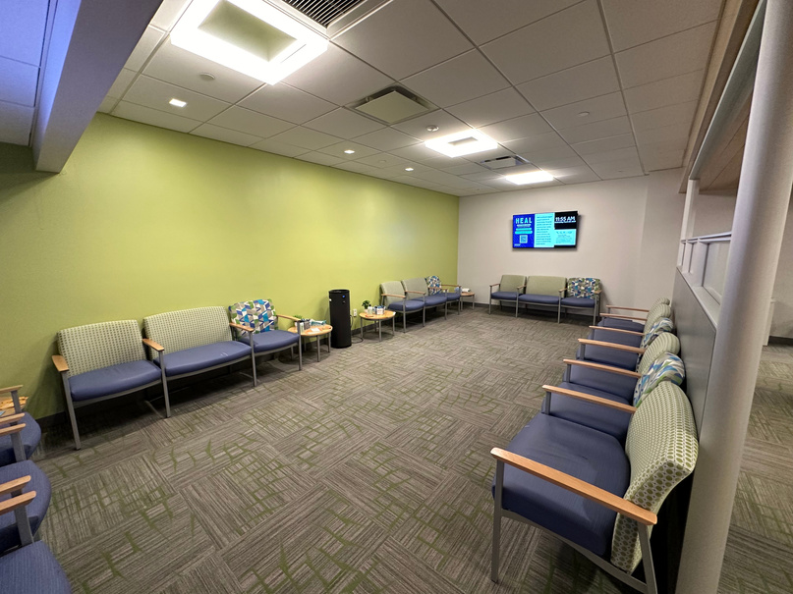




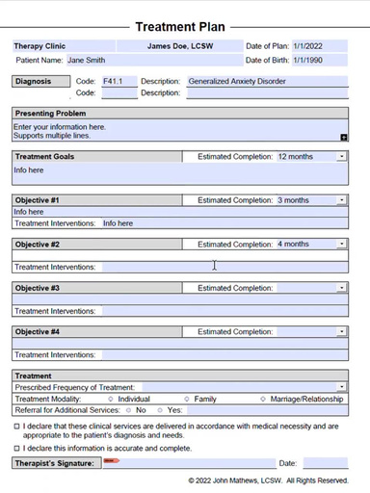

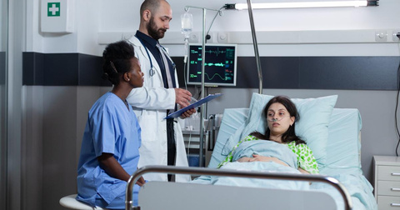



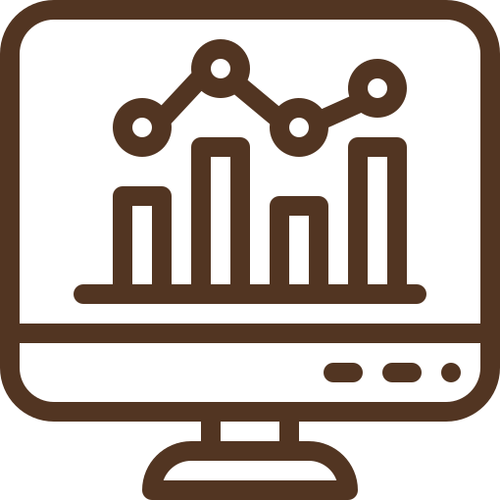
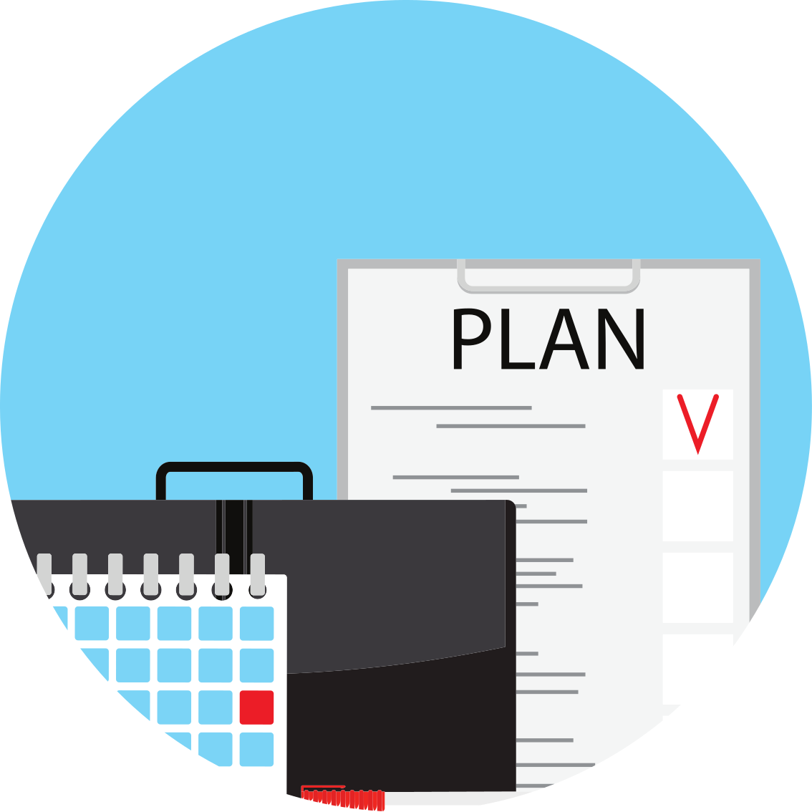
Current Emergency Care Flow
IE 5617 Graduate Project
Slide 3

Slide 7
Analysis and Goals
What is wrong with the current state
The current state of the University Health and Counseling Services (UHCS) at Northeastern University presents several challenges that negatively impact both patient satisfaction and the overall efficiency of healthcare delivery.
Documented Issues:
Extended waiting periods for patients suggest bottlenecks due to overbooking, understaffing, or inefficient scheduling and triage.
The inability to effectively prioritize urgent care cases, risking emergency care delays, indicates unclear urgency criteria or poor communication.
Interpretations:
The mismatch between patient demand and healthcare capacity suggests inefficient resource allocation due to limited visibility into patient flow and staff availability.
Prioritization issues signal process inefficiencies, with a lack of visual management tools hindering staff's ability to meet dynamic patient needs.
Possible communication gaps, as staff lack timely, clear information on patient status, complicating triage and care delivery.
4
IE 5617 Graduate Project
Slide

Slide 8
Implementation
1. Standardized Triage Criteria:
Establishing clear urgency criteria for efficient prioritization of urgent cases, minimizing delays. Utilizing the Conwin approach will help maintain balanced patient flow, ensuring optimal service speed.
2. Visual Management with Kanban Board:
Implementing a digital Kanban board for real-time patient flow tracking, reducing wait times and enhancing transparency. This system will be run using the Conwin approach to ensure balanced inflow and outflow, maintaining smooth and effective operations.
3. Process Streamlining:
Optimizing specialist referrals and in-person evaluations to reduce duplication and improve efficiency, enhancing the patient experience. The Conwin approach will be integrated to keep operations smooth and effective at all times.
4. Eliminating Bottlenecks:
In case of emergency situations eliminate long process of scheduling an appointment (Bot call - appointment selection, which is probably 1/2 days ahead)
IE 5617 Graduate Project
Slide 5

Slide 9
Value Stream Mapping
This Value Stream Map outlines our healthcare facility's patient flow, incorporating both remote and in-person check-in options to streamline the triage process. Our system includes self-check-in kiosks, specialist referral pathways, and designated queues for emergency situations. Initial analysis indicates potential bottlenecks in specialist referrals and in-person evaluations. Further examination has revealed areas where process duplication could be streamlined for efficiency.
Benefits:
Enhanced Patient Experience: Patients can visually track their progress and estimated wait times, reducing anxiety and improving satisfaction with the care process.
Increased Operational Efficiency: Enables staff to quickly identify patient status, prioritize care based on urgency, and manage patient flow more effectively, thereby reducing bottlenecks and improving the overall speed of service.
IE 5617 Graduate Project
Slide 6

Slide 10
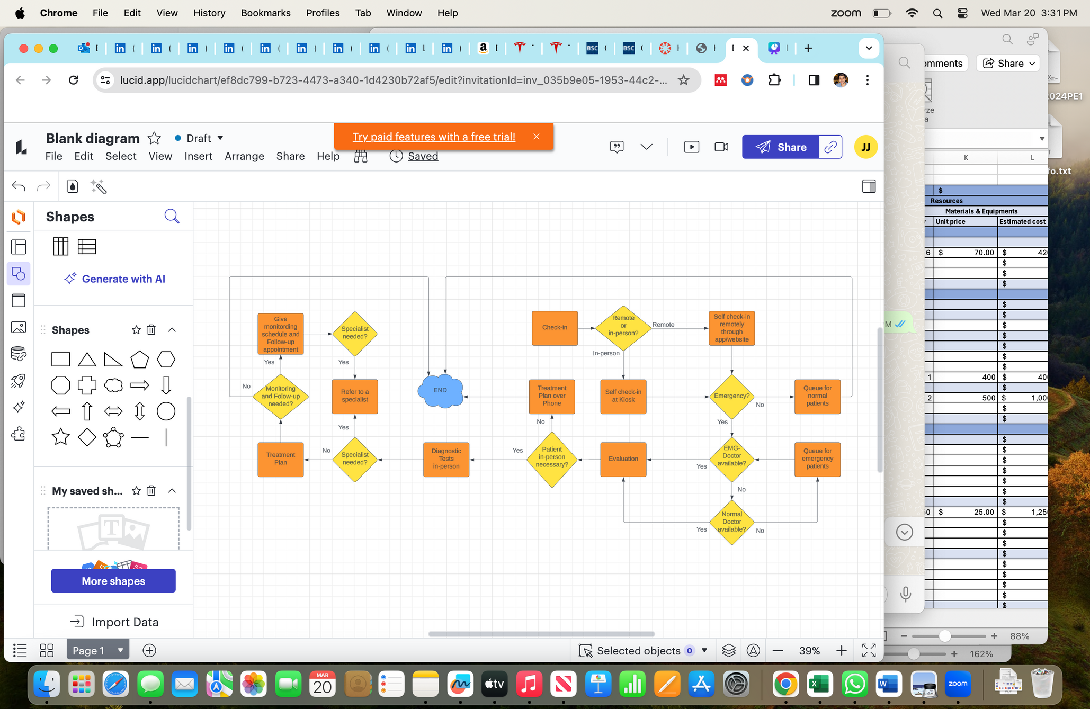
Value Stream Mapping - New
10 min
30 sec
5 min
30 sec
15-30 min
10 min
2 min
Total Cycle Time- 47.5 minutes
Improved Cycle Time by 8 Minutes
IE 5617 Graduate Project
Slide 7

Slide 11
Standard Work
In the bustling university healthcare system, managing patient flow and delivering timely care are crucial. The new Triage Protocol addresses these challenges by categorizing patients by the urgency of their needs. This streamlined approach ensures quick care for critical cases and organizes treatment efficiently for others, utilizing clear criteria to prioritize care effectively and equitably throughout the system.
Benefits:
Enhanced Patient Safety: Quick identification and prioritization of critical cases reduce risks and improve outcomes.
Improved Patient Satisfaction: Transparent communication about wait times and care levels boosts patient experience.
Optimized Resource Utilization: Efficient use of resources and staff, reducing delays and improving care delivery.
IE 5617 Graduate Project
Slide 8

Slide 12
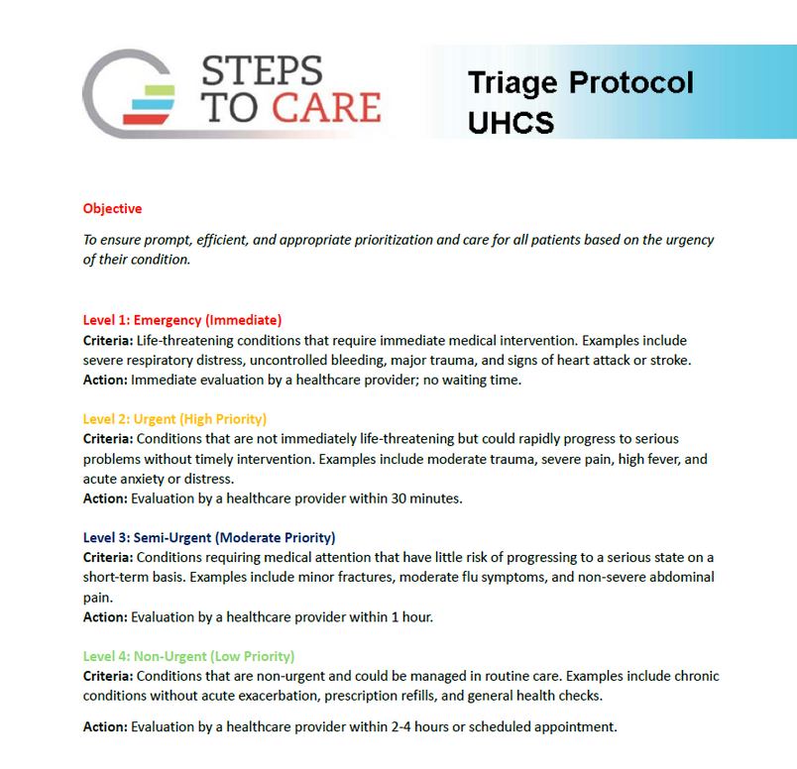
IE 5617 Graduate Project
Slide 9

Slide 13
ERP Integrated Kanban Board
We propose an Excel-based Kanban board that will be linked with the EHR system or other digital tools. This setup can help in automatically updating the Kanban board as patients move through different stages of their healthcare journey, revolutionizing patient flow management from registration to treatment in the initial assessment area.
Benefits:
Improved Operational Efficiency
Automated Updates: Automates patient progress updates, reducing manual tasks.
Real-Time Visibility: Allows for quick adaptation to patient flow changes, improving resource use.
Enhanced Patient Experience
Reduced Wait Times: Helps promptly identify and address bottlenecks.
Increased Transparency: Keeps patients informed about their care timeline.
IE 5617 Graduate Project
Slide 8

Slide 14
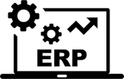

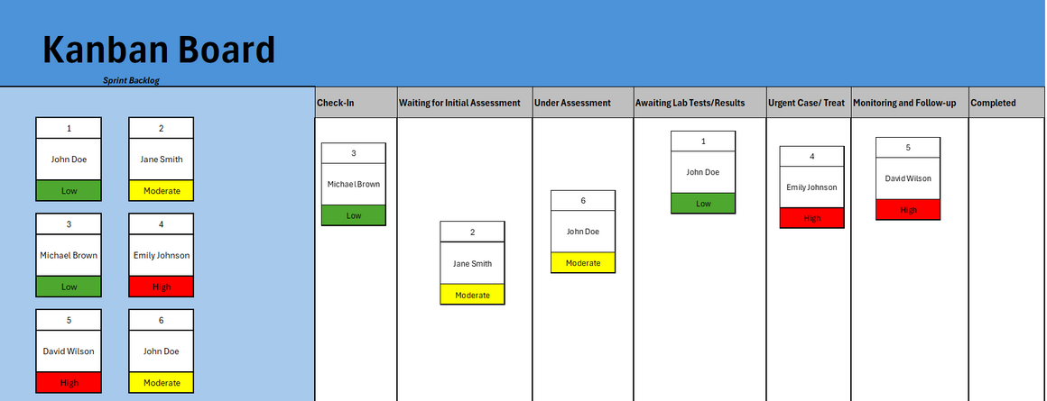
ERP Integrated Kanban Board
IE 5617 Graduate Project
Slide 9

Slide 15
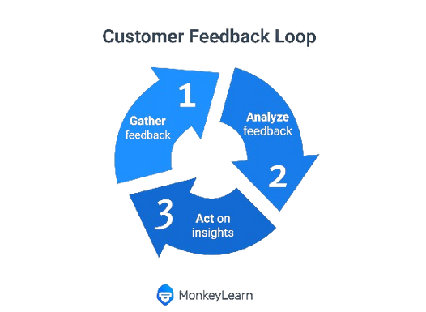
Kaizen (Continuous Improvement)
Continuous refinement and enhancement are at the core of our project. By adopting the Kaizen Continuous Improvement approach. Our project aims to achieve sustained improvements in patient flow management and healthcare delivery at UHCS. Here's how Kaizen will be integrated into our project:
Benefits:
Proactively address challenges and inefficiencies in real-time.
Continuous Feedback Loop: Establishing channels for staff and patient feedback to gather insights into the effectiveness.
Cultivate a culture of innovation and collaboration among staff members.
Enhance overall operational effectiveness and patient satisfaction.
Ensure that the Excel-based Kanban board system remains responsive and adaptable to the dynamic healthcare environment.
IE 5617 Graduate Project
Slide 8

Slide 16

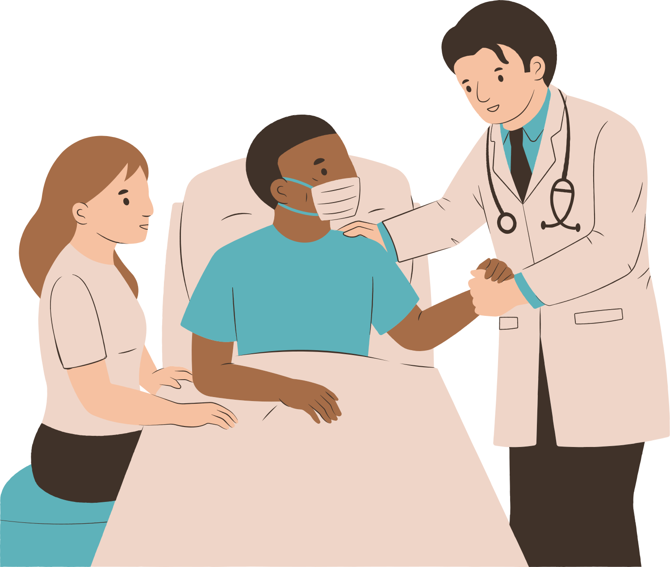
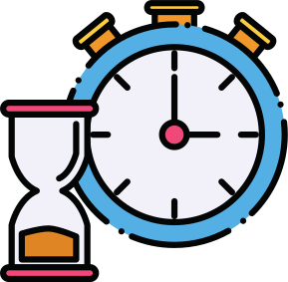

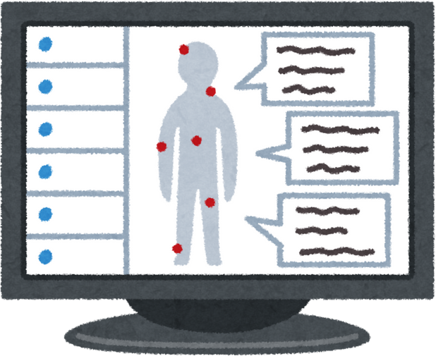
Follow Up
Results would be achieved
1. Reduced wait times
2. Improved prioritization of urgent care
3. Increased operational efficiency
Next Steps:
1. Implement electronic health record (EHR) integration
2. Develop a phased plan to implement the system across other UHCS facilities
Lessons Learned:
1. Importance of visual management tools
2. Emphasized on how data analysis from wait times and patient feedback helped refine the system and improve outcomes
IE 5617 Graduate Project
Slide 10

